Slide 1

MACHINE LEARNING

Slide 2
PROBLEM WITH DECISION TREE
Decision tree is very prone to overfitting

Slide 3
ENSEMBLE MODELS
Ensemble method is a technique that combines several base models in order to produce one optimal predictive model.
Model -1
Model -2
Model - 3
FINAL MODEL

Slide 4
TYPES OF ENSEMBLE MODELS
BAGGING
BOOSTING

Slide 5
BAGGING OR BOOTSTRAP AGGREGATING
Bagging is a way to decrease variance in prediction by training several decision trees and combining their predictions.
TREE -1
TREE -2
TREE -3
TREE -4

Slide 6
HOW BAGGING WORKS ?
BOOTSTRAP
AGGREGATION
D A T A
S
E
T
S-1
M-1
0
S-2
M-2
1
Max Vote
S-3
M-3
0
0
S-N
M-N
0

Slide 7
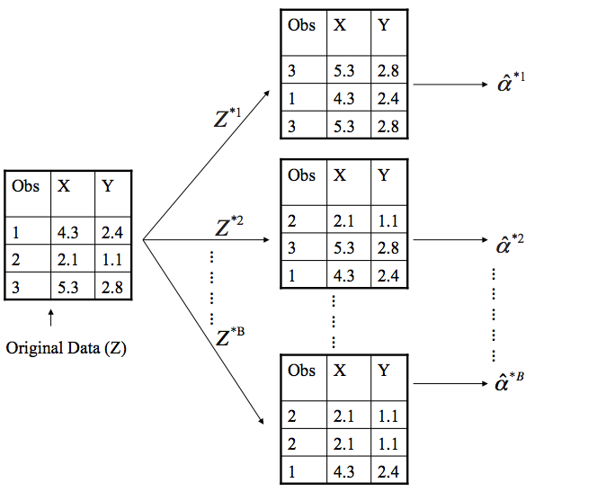
HOW BAGGING WORKS ?
In bagging we do row sampling with replacement so there is a chance that the the same data points gets selected multiple times

Slide 8
RANDOM FOREST
Random forest classifier is a set of decision tree from randomly selected subset of training set.
It aggregates the votes from different decision trees to decide the final class of the output.
TREE -1
TREE -2
TREE -3
TREE -4
0
1
1
1
MAX VOTE
1

Slide 9
In random forest sampling is done for rows as well as columns.
OBS | P | S
0 | 4.2 | 4.3
3 | 2.1 | 4.2
OBS | S | P | C
0 | 2.23 | 4.2 | 4.3
1 | 3.34 | 3.6 | 3.6
3 | 4.2 | 2.1 | 4.2
4 | 3.8 | 4.6 | 2.4
OBS | P | C
4 | 4.6 | 2.4
0 | 4.2 | 4.3
OBS | S | P
0 | 2.23 | 4.2
1 | 3.34 | 3.6

